Slide 1
Company Profile
S A V N
Consulting Services (P) Ltd.
Consulting Services (P) Ltd.
www.savnindia.com
May 2015

Slide 2
Structure of the Presentation
Vision & Mission
Expertise and focus sectors
General Guidelines & Targets
About the Partners & their Experience
(detailed CVs are emailed separately)

Slide 3
Inception & Vision
SAVN Consulting Services Private Limited is founded to provide Consultancy and Project Management services for design and development of infrastructure projects. Our team of experts comprise highly qualified and experienced professionals having significantly contributed in many important projects in India and Internationally.
Vision: To become a niche consulting company which lays supreme importance on local research towards finding solutions for Indian Infrastructure.

Slide 4
Expertise and Focus Sector
Expertise:
Urban & Regional Planning
Architecture & Urban Design
Civil Engineering works related DPRs
Project formulation for SMEs and Developers
Socio-Economic Research and Analysis
Focus Sectors:
Urban Planning, Logistics, Tourism, Aviation, Small & Medium Enterprises Setups, Education

Slide 5
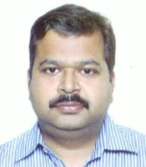
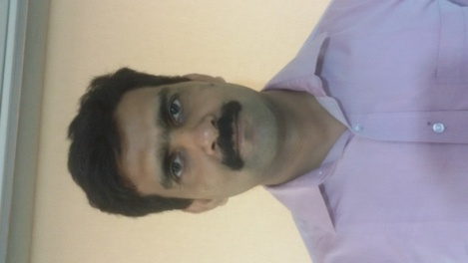
About the Partners
Vikash is an alumnus of IIFT, Delhi and CEPT Ahmedabad with 15 years experience in Architecture & Urban Design projects in India, Pakistan and Canada.
Key Projects- Perspective plan for Tehri Lake Area development, Tourism Master Plan of Braj Region; Urban Design of Lea Market, Karachi; Revitalization of the China Town Vancouver, International Airport at Kushinagar etc.
Vikash Chandra
MBA, M.Arch, B.Arch
Arun is Civil Engineer –Planner and an alumus of CEPT Ahmedabad . He has more than 20 years experience in Master planning and execution of Community based Urban and Regional Planning projects.
Key Projects- PURA- A PPP rural development pilot by MoRD, The SWAJAL project- funded by World Bank (1999-2002), JNNURM DPRs for BSUP.
Arun Kumar Singh
MBA, M. Plan, B.E (Civil)

Slide 6
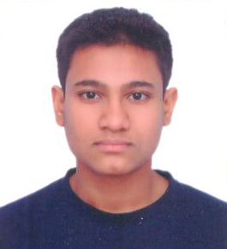
About the Partners
Naveen is a an alumnus of IIM Ahmedabad and Patna University, with more 15 years experience in developing Logistics, Free trade warehousing, Solar and hydropower projects
Key Projects- Development Free Trade Warehousing Zone (FTWZ) in Kandla, Haldia and Greater Noida, Movement of Fertilizers and other cargo on Waterway-I, technical and commercial viability studies for new hydropower projects
Naveen Kumar
MBA, B.E (Civ il)
Shivam is a young entrepreneur having graduated from the University of Michigan with a major in Economics and a certificate in Program in Entrepreneurship.
Key Projects- He has exhibited high skills in Programming and Data Structures Statistics and Econometrics, while analysing various government schemes and polices.
Shivam Shankar Singh
B.A (Economics)

Slide 7
Consulting Services offered
Financial Modeling/ Economic survey
Feasibility
Studies
Detailed Architectural drawings
Detailed Project Reports
Assisting in regulatory approvals
Getting project sanctions under Government schemes
Project
Management
Tender Design and documentation

Slide 8
Project Experience of the Partners
To be emailed subsequently.

